Slide 1
Load data directly from Cropdiversity server to Dataheap
Zed Chen
10/06/2025

Slide 2
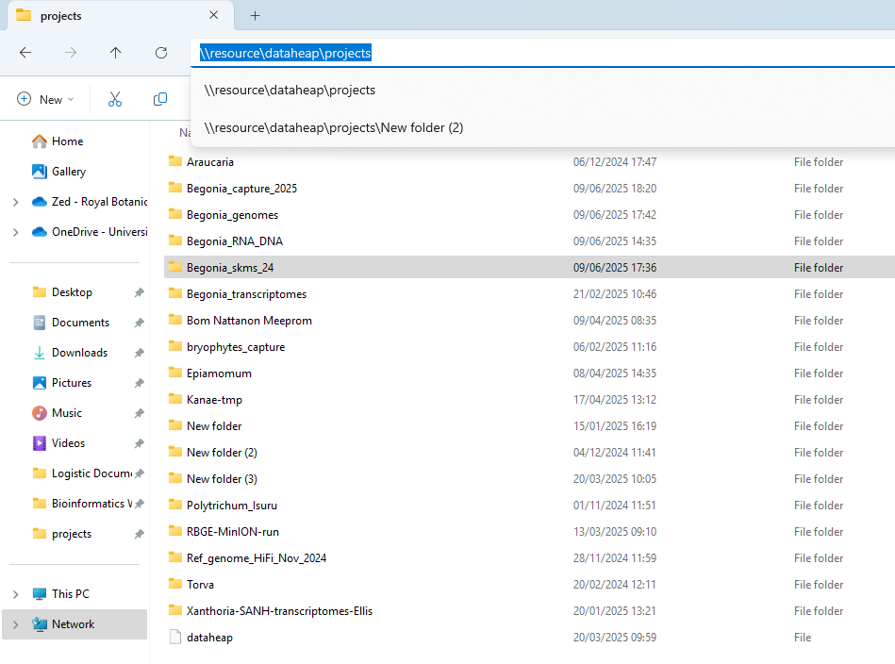
Navigate to Dataheap
Open file explorer and enter: \\resource\dataheap\projects

Slide 3
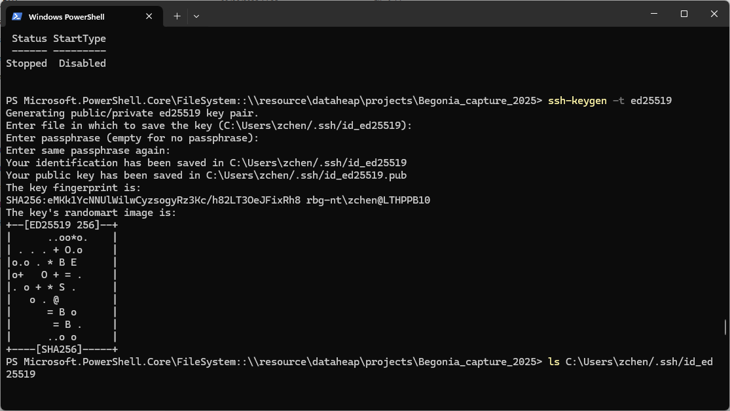
Open a terminal window within Dataheap
Right click → Open in Terminal
You will see a Windows PowerShell

Slide 4
For the first time: Key authentication with SSH key pair.
To access files from Cropdiversity via a remote server, you need to establish a connection first, ideally with SSH key pair.
With the same method, you can also access files on Cropdiversity servers from Toby

Slide 5

Guides for key authentification
Useful link for more detailed explanation:
Getting Connected — Crop Diversity HPC Help documentation
→Getting Connected → Key authentication (with 2FA) → Terminal Clients Connection Guide (Keys)
In the terminal window, type:
ssh-keygen -t ed25519
Set your passphrase (or just type enter for ‘blank’ passphrase)
Once the key pairs are generated, you’ll see the key’s randomart image in the terminal:

Slide 6
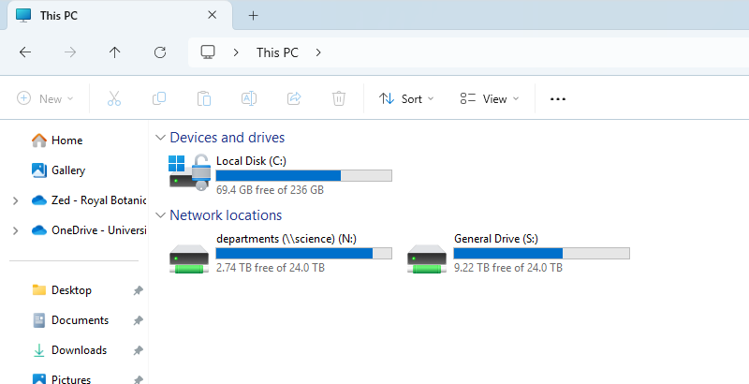
Guides for key authentification
Keep you private key safe!!!
But we need to share the public key to set up access
Where to find:
The keys are on local disk C:
But we can access the key from the terminal as well

Slide 7
Guides for key authentification
The keys are saved on a ‘hidden’ directory called .ssh
In terminal, type:
ls C:\Users\xxxx/.ssh
Replace xxxx with your actual rbge username
Now you can see all the files in .ssh, including the key pairs
To view the public key, type:
cat C:\Users\xxxx/.ssh/id_ed25519.pub
You will see something like this in the window:
ssh-ed25519 AAAAC3NzaC1lZDI1NTE5AAAAIFQ3CTmAhHATjayqAA8OjYp6z3XVTSZROn8QIWjQ7fxq rbg-nt\zchen@YOURMACHINE
YOURMACHINE is the actual ID of the machine/server you are using to connect to Cropdiversity

Slide 8
Share the public key
Copy the text from the ‘cat’ command
Send it to Iain Milne
Once he set up the public key, the key pair will allow you to access Cropdiversity from the server
Useful link for more detailed explanation:
Getting Connected — Crop Diversity HPC Help documentation
→Getting Connected → Key authentication (with 2FA) → Terminal Clients Connection Guide (Keys)

Slide 9
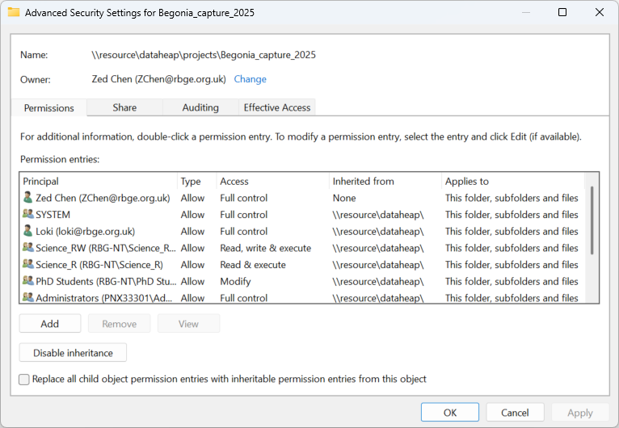
Create a new directory on Dataheap
Right click to create a new folder
You’ll realize you cannot rename the folder
Now rightclick on the folder: Properties → Security → Advanced.

Slide 10
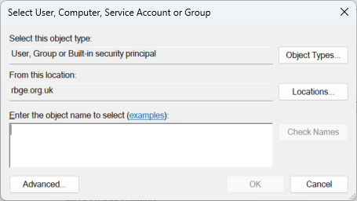
Create a new directory on Dataheap
Click Add → Select a Principle
Enter your rbge username
Click OK

Slide 11
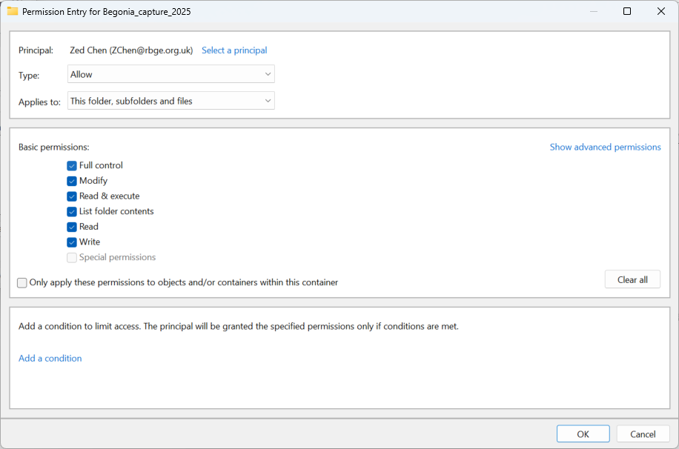
Create a new directory on Dataheap
Then under basic permissions:
Select ‘Full Control’
Click OK → Apply → OK → OK
You are all set! Now you have full control over the directory you just created
You can rename it and modify its content, including deleting files
Without changing the permission, you can only upload files to the directory

Slide 12
Backup files from CropDiversity
Back to the terminal (presumably you are still in \\resource\dataheap\projects )
Navigate to the directory by typing:
cd NAME_OF_YOUR_NEW_DIRECTORY
Start safe copy (scp):
scp zchen@gruffalo.cropdiversity.ac.uk:/mnt/shared/projects/rbge/FULL_PATH_TO_THE_DIRECTORY/FILE_YOU_WANT_TO_UPLOAD .
Don’t forget the ‘ . ’ at the end. It tells scp to put the copied content in the current directory
Now it should be busy loading content

Slide 13
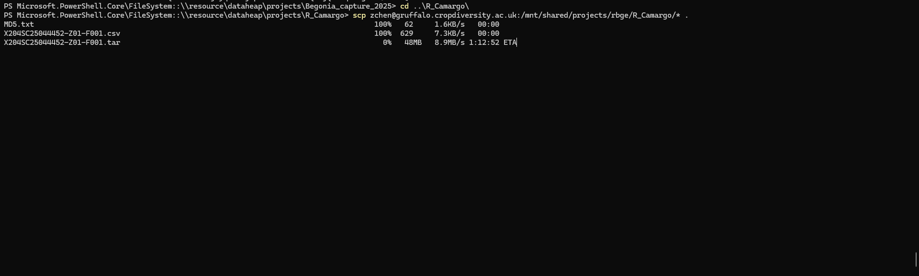
For instance

Slide 14
Mount Dataheap on Toby
mkdir A_DIRECTORY_WHERE_YOU_WANT_DATAHEAP_TO_BE_MONTED
I made one at /home/zchen/dataheap on Toby
sudo mount -t cifs //resource/dataheap /home/zchen/dataheap -o username=USER@rbge.org.uk,password=RBGE_PASSWORD,uid=$(id -u),gid=$(id -g)
ALL SET!

Slide 15
Backup files from Toby (Much much faster than using a local terminal to transfer!!!)
Now you can directly manipulate your Dataheap files from Toby
Can copy files directly over from Toby
Can scp from cropdiversity
Can download directly (e.g. from Novogene)
E.g. download the csv file
wget -i ./X204SC25065191-Z02-F001.csv
Directly downloading files from Novogene cloud storage

